Slide 1

FEEL GOOD
-Priya Parmar

Slide 2
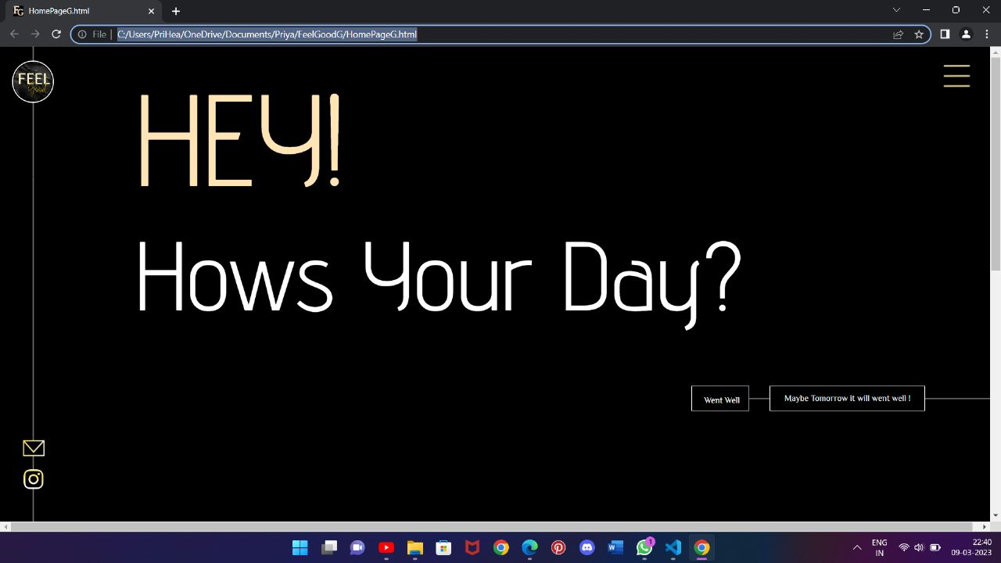
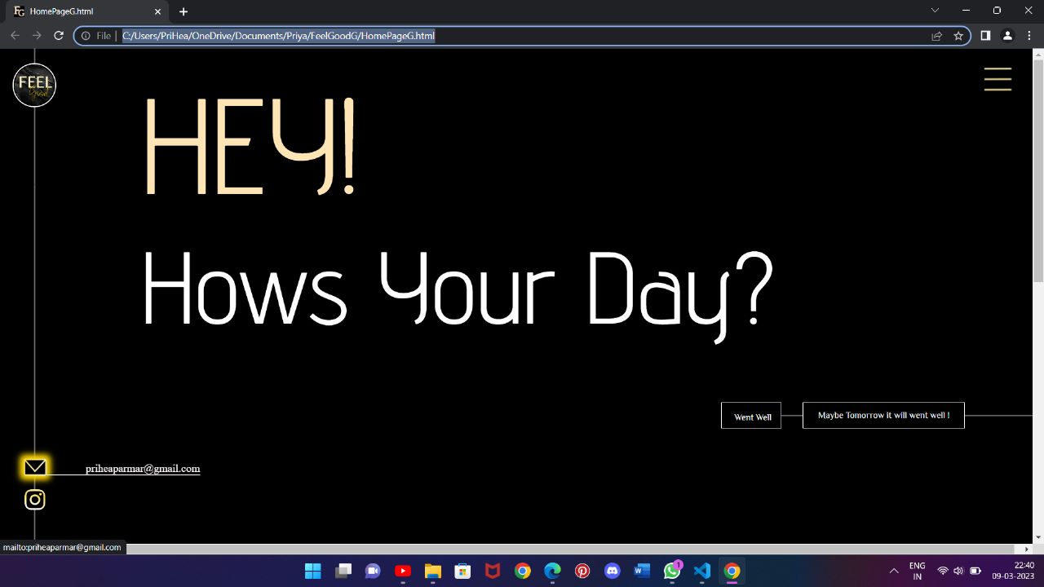
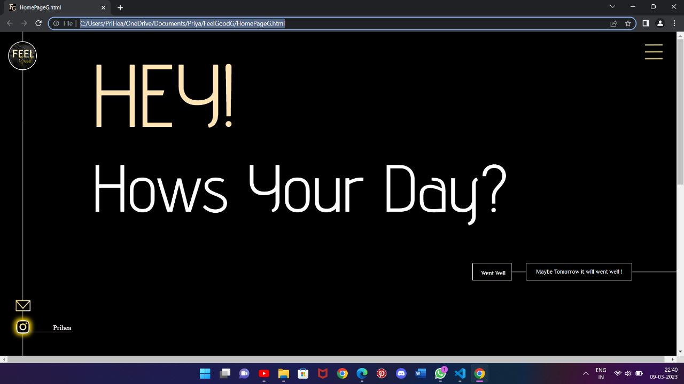
This is the Home Page of My Website
The mail logo and the insta logo in the bottom contains mail and insta id link followed up with the hover effect when you click on one of them it will redirect you to the mail or insta page

Slide 3
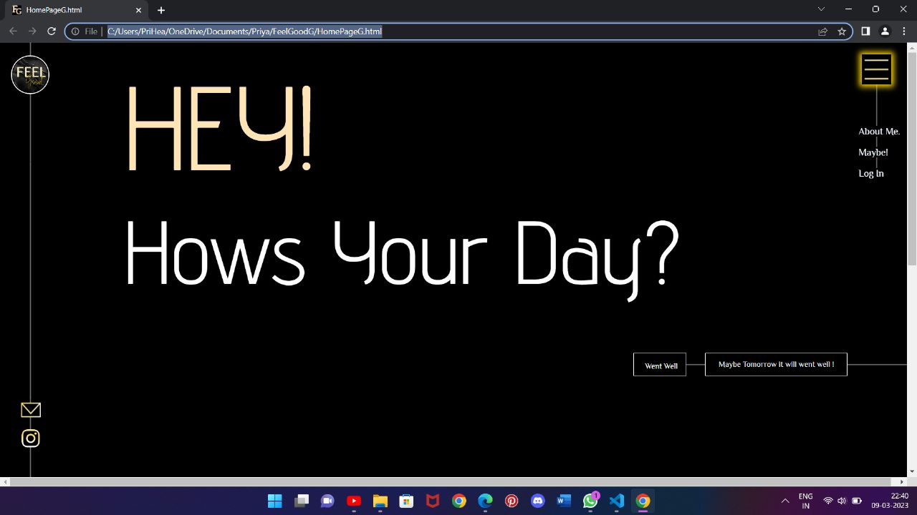
At the top menu logo when we hover it, it dropdowns the - About me - Maybe! -Log In section

Slide 4
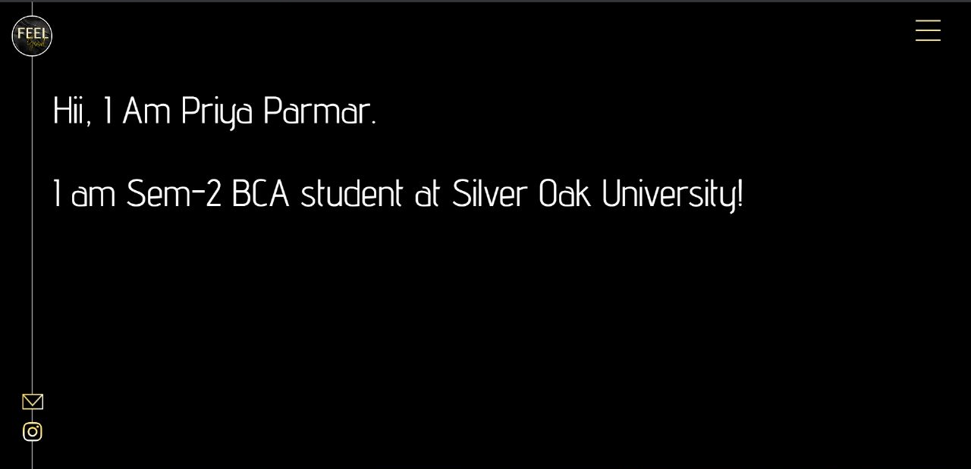
When you click on about me
It will open up a page containing my little information

Slide 5
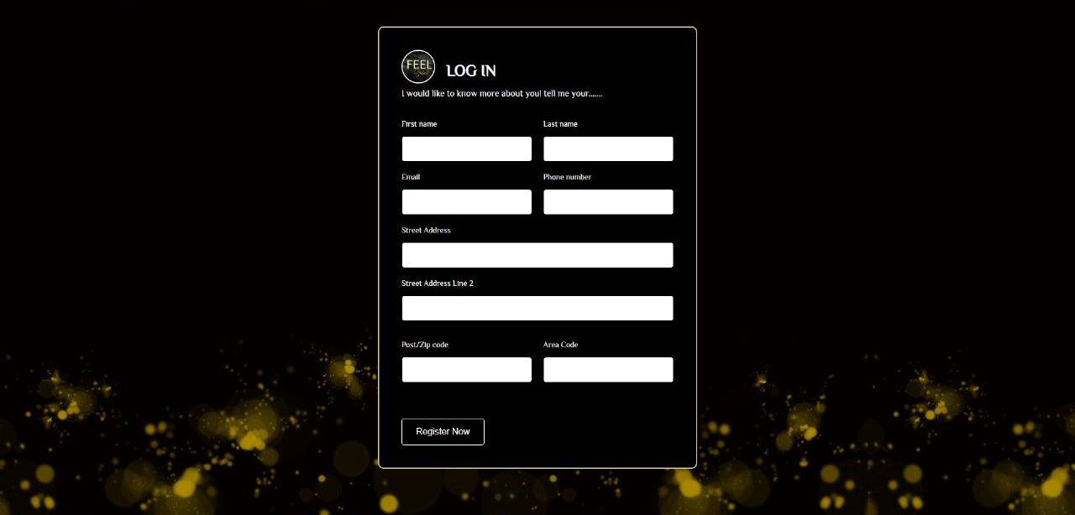
When you click on login. It will open up a login page

Slide 6
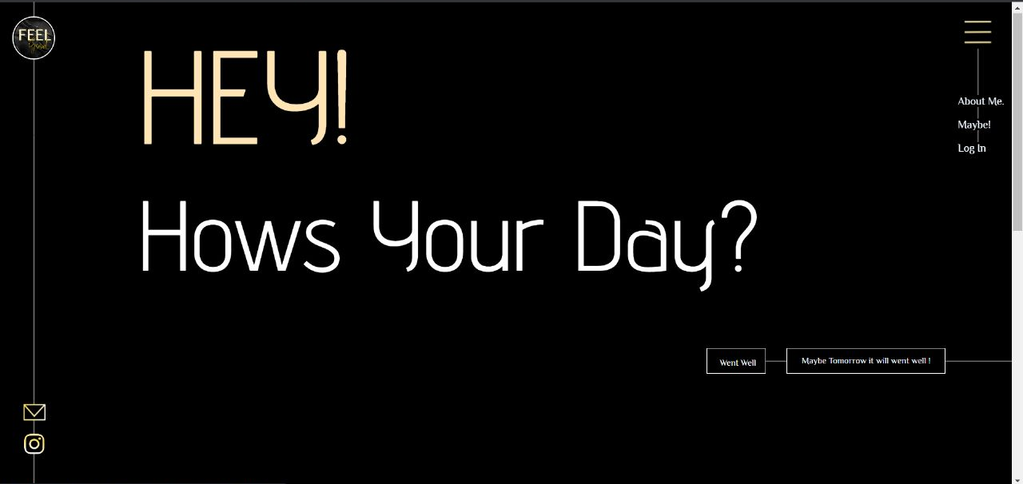
Back to the home page, it asks you about how’s your day?

Slide 7
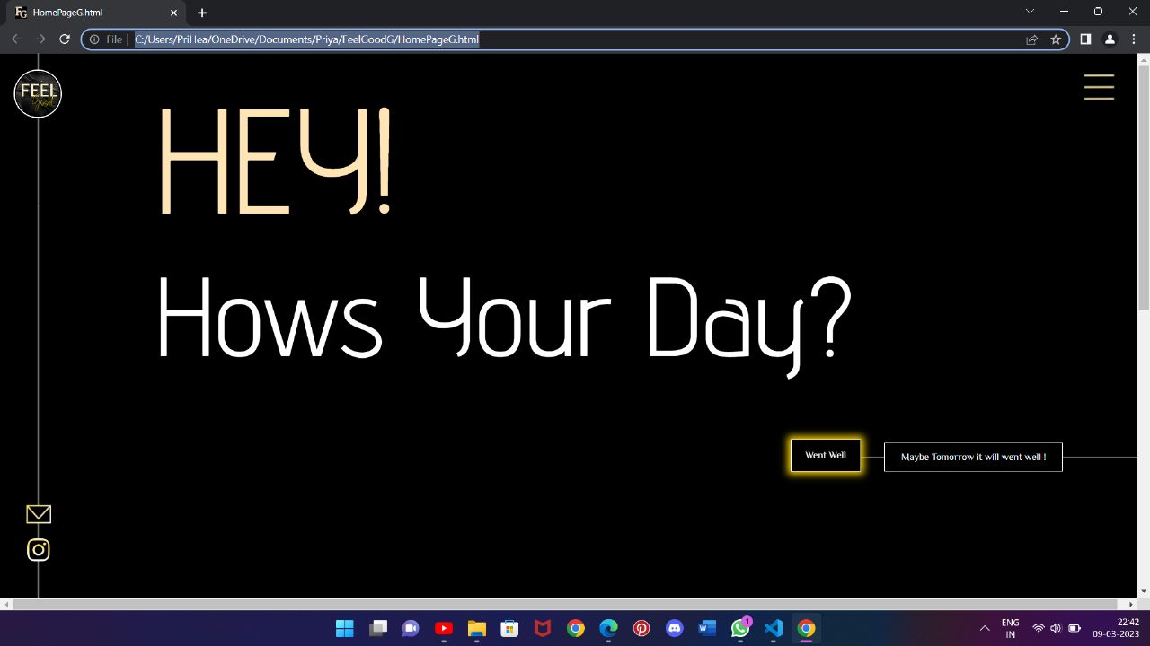
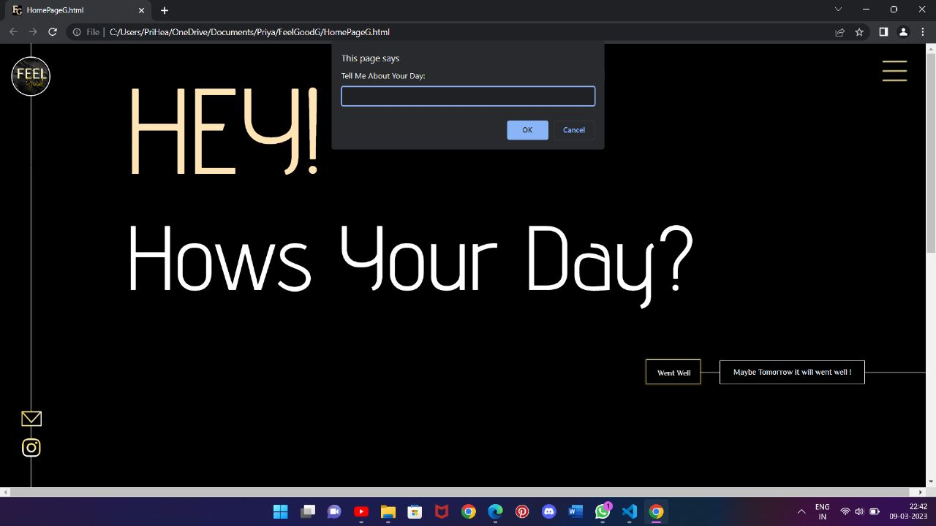
WHEN YOU CLICK WENT WELL IT WILL OPEN A POP UP LIKE……. You have to tell about how good your day went!

Slide 8
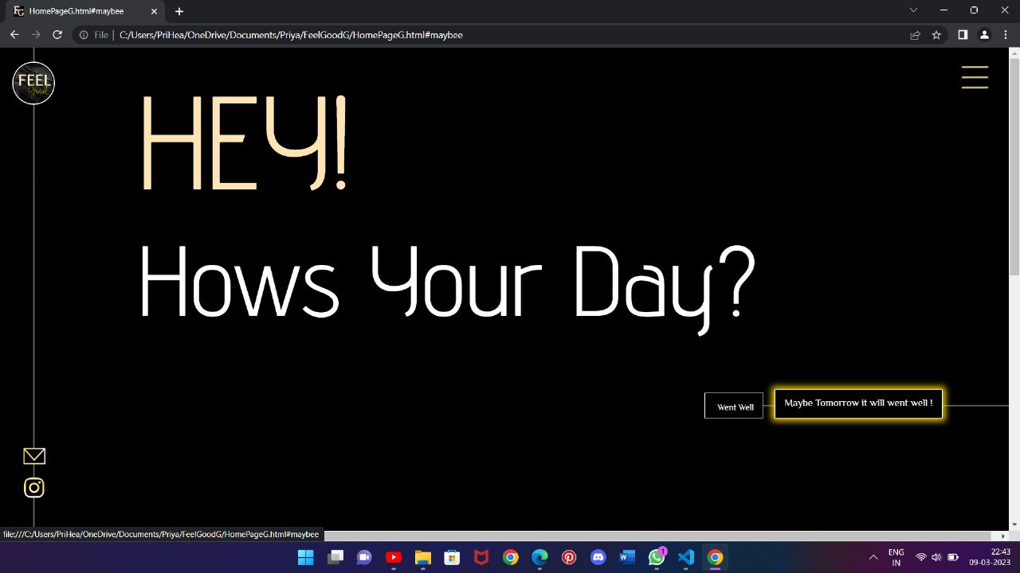
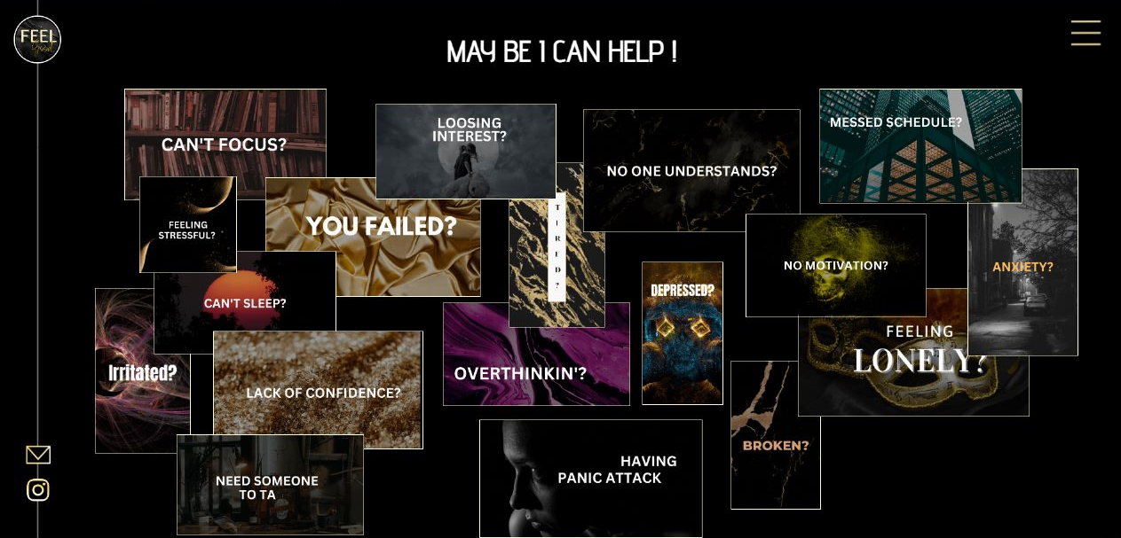
When you click on may be…..tommorow
It will open up a page like
When you click on any one help it will redirect you to that particular help page

Slide 9
